Slide 1




How to Join MS Developer Program
Prepared By :
Said Fawzy
Manager of Information Center
Tendering Department
Arab Contractors

Slide 2

How to Join MS Developer Program

Slide 3
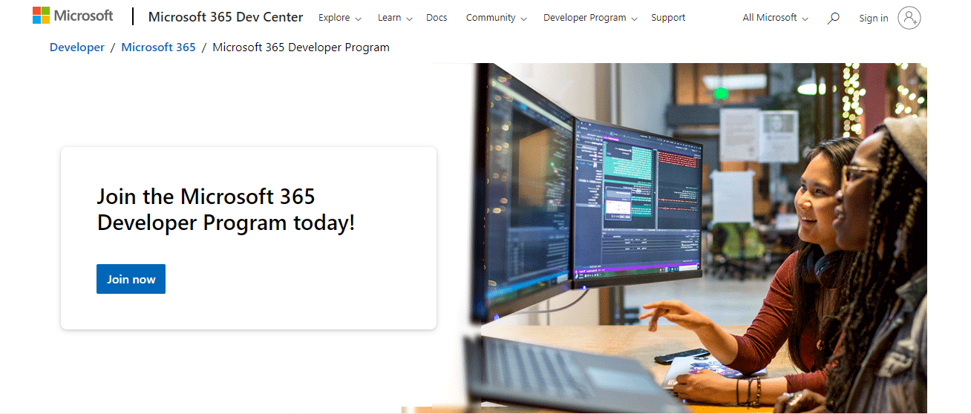
Go to Developer site
https://developer.microsoft.com/en-us/microsoft-365/dev-program

Slide 4
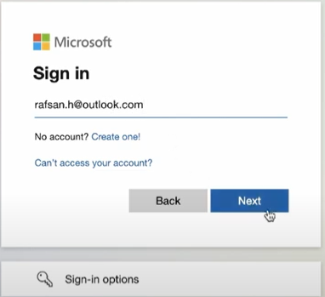
Click Sign In and sign in with your personal account or create new account
Your name

Slide 5
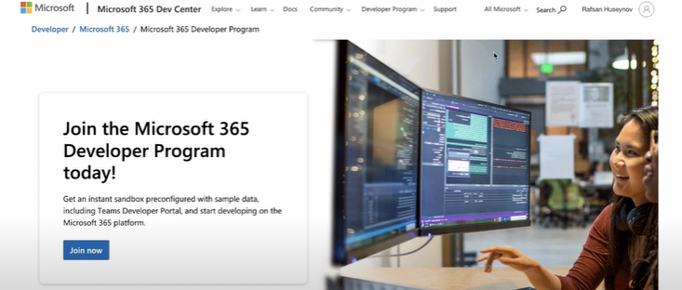
Your name

Slide 6
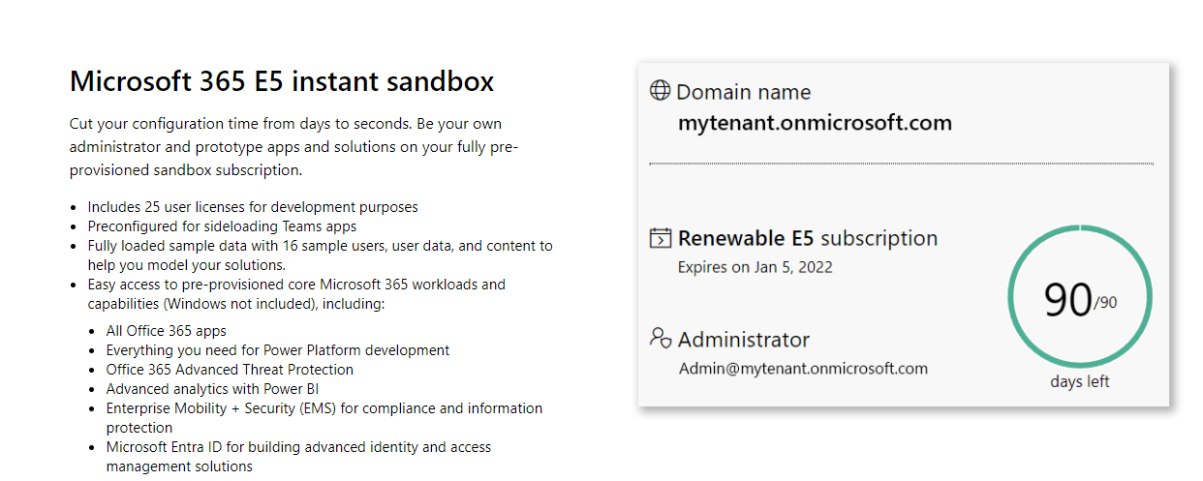
You can go down and see benefits of joining the program

Slide 7
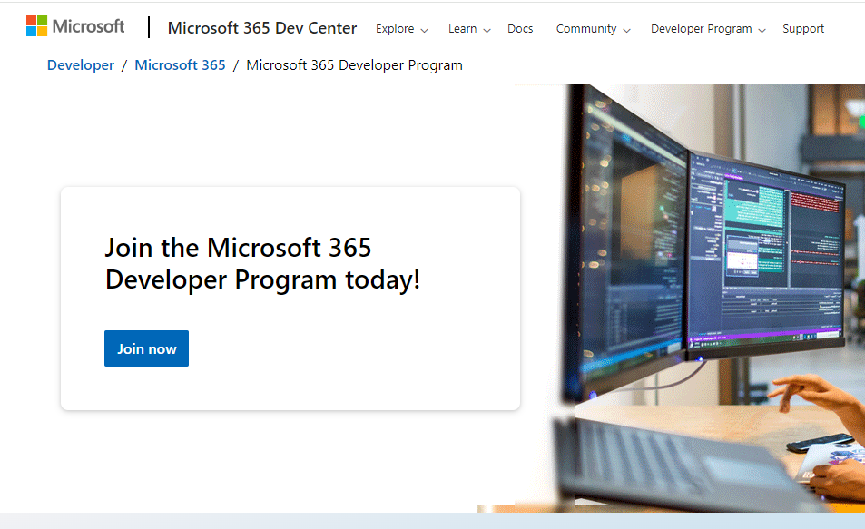

Slide 8

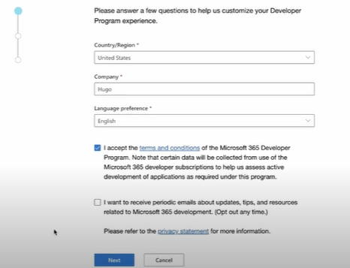
Egypt
AC

Slide 9
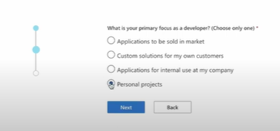

Slide 10
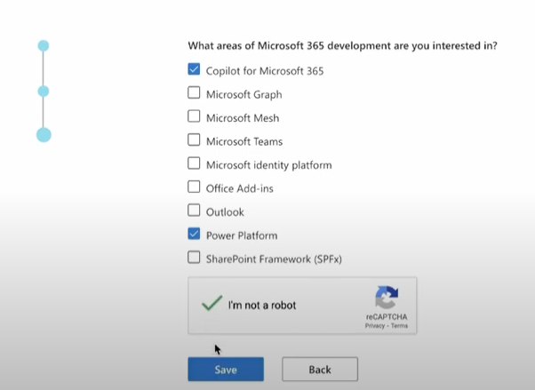

Slide 11
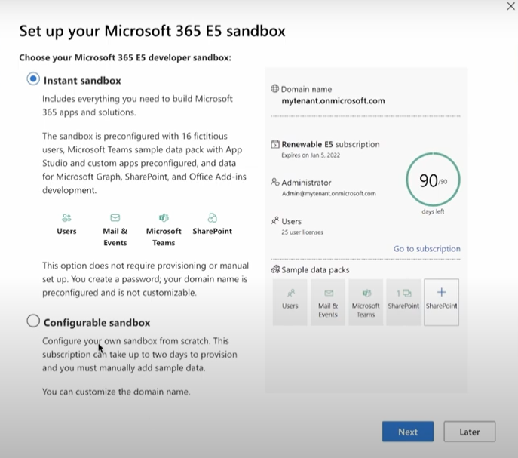

Slide 12
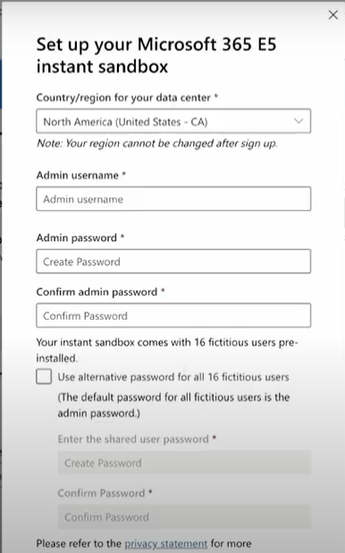
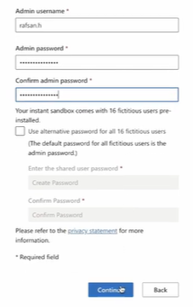
Administrator
Egypt

Slide 13
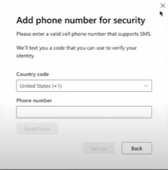

Slide 14
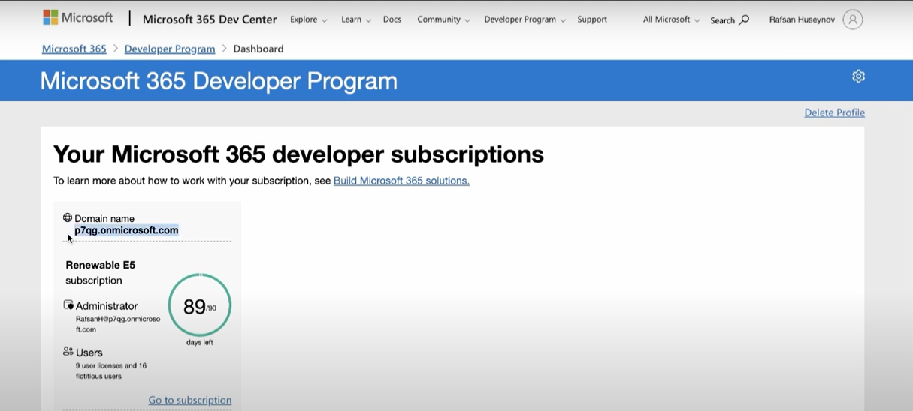
Copy and keep your
administrator account

Slide 15
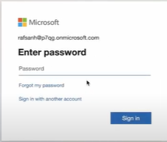

Slide 16
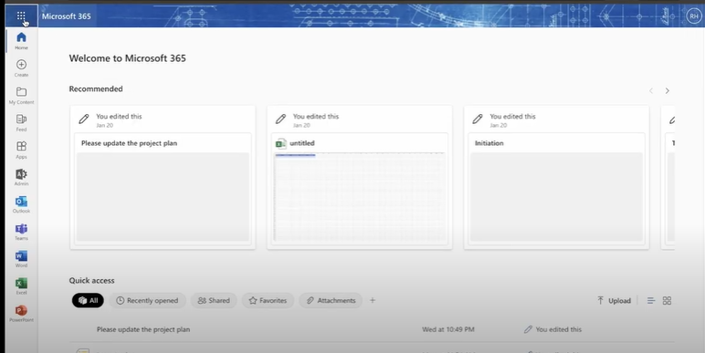

Slide 17
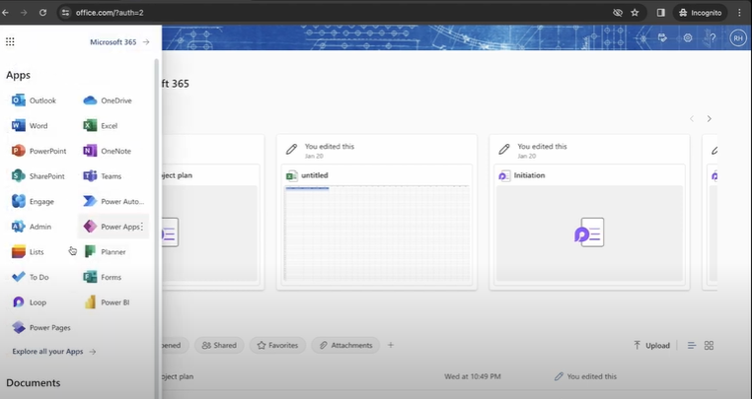

Slide 18
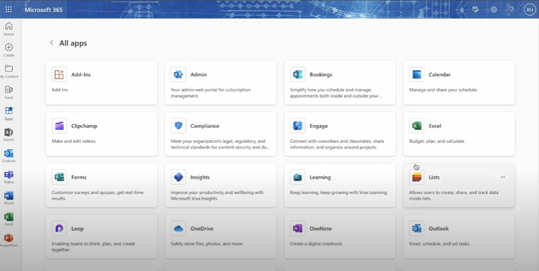

Slide 19
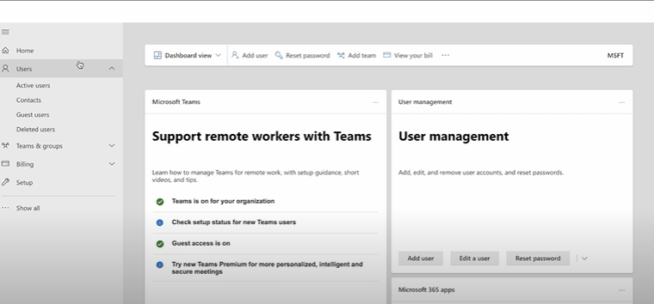

Slide 20
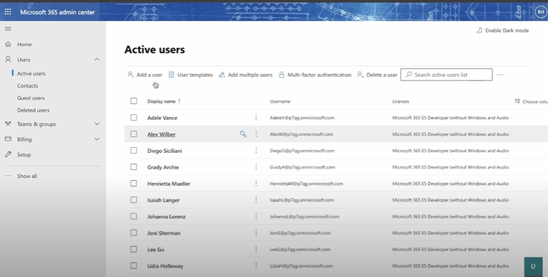

Slide 21
